Slide 1
Negotiation and the Management of Conﬂict
“the process which begins when one party perceives that the other has frustrated, or is about to frustrate, some concern of his”
Conflict is serious disagreement

Slide 2
According to the web page of the New York State Bar Association, there are approximately 850,000 lawyers in the United States. The great majority of this group that numbers between 25 and 35 percent of the world’s supply of lawyers are employed in helping conﬂicting parties to adjudicate or settle their differences

Slide 3
THE NATURE OF NEGOTIATION
The favored technique for resolving conﬂict is negotiation.
“the process through which two or more parties seek an acceptable rate of exchange for items they own or control”
“Negotiation is a ﬁ eld of knowledge and endeavor that focuses on gaining the favor of people from whom we want things

Slide 4
(Roget’s I nternational Thesaurus, 1993) synonyms for “ negotiate” in some instances
“negotiation,” we do recognize that such terms as “mediate,” “conciliate,” “make peace,” “bring to agreement,” “settle differences,” “moderate,” “arbitrate,” “adjust differences,” “compromise,” “bargain,” “dicker,” and “haggle”
Because each unit will have its own goals, integrating the activities of two or more units is certain to produce the conﬂicts

Slide 5
a Pareto-optimal solution
The concept of a Pareto-optimal solution is important
The PM must remember that she will be negotiating with project stakeholders many times in the future
The proper outcome of this type of negotiation should be to optimize the outcome in terms of overall organizational goals

Slide 6
PARTNERING
outsourcing parts of projects
Project partnering is a method of transforming contractual relationships into a cohesive, cooperative project team with a single set of goals and established procedures for resolving disputes in a timely and effective manner.

Slide 7
PARTNERING
The parent ﬁrm must make a commitment to partnering, select subcontractors who will also make such a commitment, engage in joint team-building exercises, and develop a “charter” for the project. (See the next subsection for a description of such a charter.) Second, both parties must implement the partnering process with a four-part agreement on:
(1) “joint evaluation” of the project’s progress;
(2) a method for resolving any problems or disagreements;
(3) acceptance of a goal for continuous improvement (also known as TQM) for the joint project; and
(4) continuous support for the process of partnering from senior management of both parties

Slide 8
Chartering
The agreements between groups partnering on large endeavors are often referred to as charters.
A project (program, etc.) charter is simply a written agreement between the PM, senior management, and the functional managers who are committing resources and/or people to a speciﬁ c project (program, etc.)
it details the expected deliverables, often including schedules, budgets, and resource commitments

Slide 9
Chartering
It attests to the fact that senior management of all relevant organizations, functional managers, and the PM are “on the same page,” agreeing about what is to be done, when, and at what cost.

Slide 10
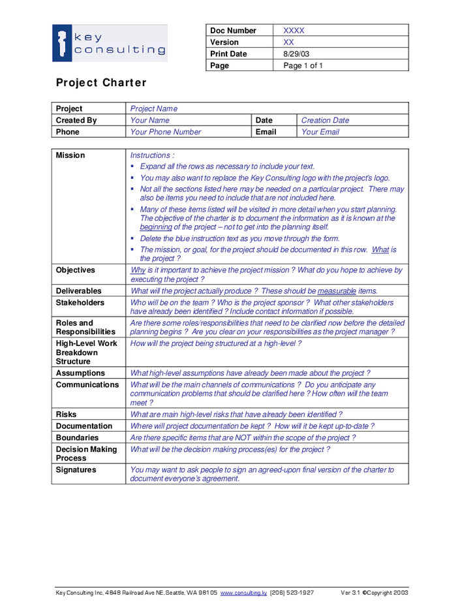

Slide 11
Conflict
conﬂicts between any of the parties to the project escalate to the point where negotiations break down and work comes to a halt, everyone loses.
One requirement for the conﬂict reduction/resolution methods used by the PM is that they must allow the conﬂict to be settled without irreparable harm to the project’s objectives.
It is a requirement of all conﬂicting parties to seek solutions to the conﬂ ict that not only satisfy their own individual needs, but also satisfy the needs of other parties to the conﬂict, as well as the needs of the parent organization.
In the language of negotiation, this is called a “win-win” solution. Negotiating to a win-win solution is the key to conﬂict resolution in project management

Slide 12
Principled negotiation
Separate the people from the problem
Emotions and objective fact get confused to the point where it is not clear which is which.
Focus on interests not positions
“We might be able to deliver it by February 1.” The ﬁ rst position assumes that the bidder’s estimates of future property values are accurate, and the second assumes that the group’s current workload (or a shortage of required materials) will not change
Before trying to reach agreement, invent options for mutual gain
Success at ﬁnding options that produce mutual gain positively reinforces win-win negotiations. Cohen (1980) reports on a conﬂict between a couple in which “he” wanted to go to the mountains and “she” wanted to go to the shore. A creative win-win solution sent them both to Lake Tahoe
Insist on using objective criteria
Insist on using objective criteria. Rather than bargaining on positions, attention should be given to
ﬁnding standards (e.g., market value, expert opinion, law, company policy) that can be used to determine the quality of an outcome.

